Slide 1
Colonizing Mars One Step at a Time
Team: Martians
Members: Jihal P. Pouya S. Sharujan R.

Slide 2
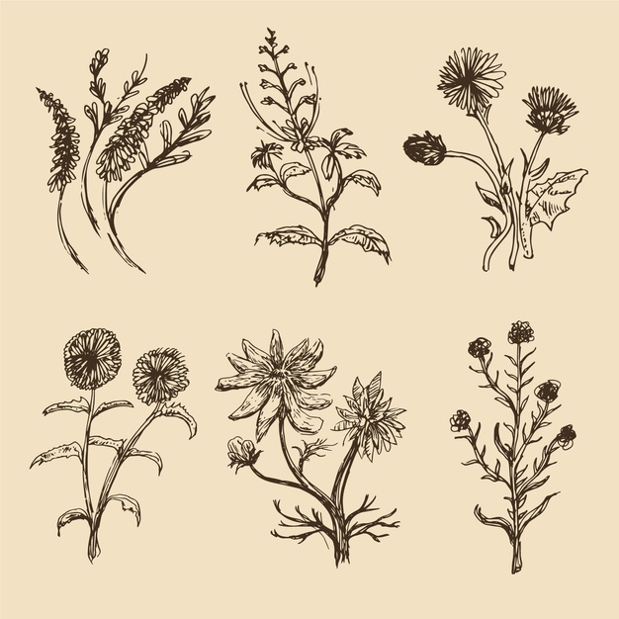

Long Term Needs on Mars
Lasting structures for habitat
Growth and evolution of Botany on Mars for sustainable food resource
Use of Martian resources to minimize cost and time between interplanetary travels
Reusing of waste (Human/Environmental)

Slide 3
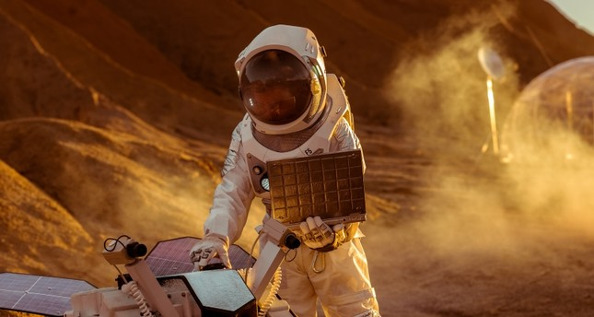
Getting to Mars
Current rockets are not able to carry much payload (~5% of mass) to the low earth orbit (and lower to mars) meaning taking a lot of materials would not be a viable option
It takes about 150-300 days to get to mars depending on the speed of the launch, and how much fuel we are willing to burn.

Slide 4
Robots before Humans
Before sending humans to Mars, it would be smarter to send robots in order to create a habitat for humans to live in
The process would require automated robots capable of 3D printing and shielding the 3D printed materials
Along with that they should be able place systems that allow oxygen generation

Slide 5
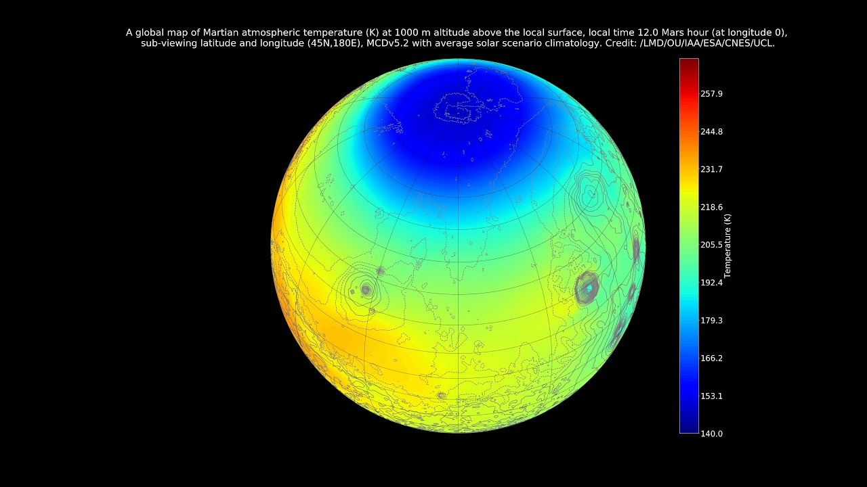


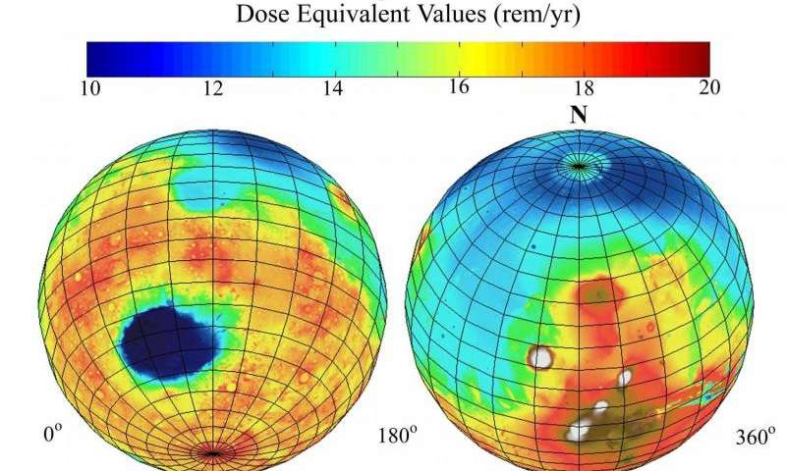
Habitable Structure Design Criteria
Rigid to withstand extreme conditions
Must withstand solar radiation
Immune to severe temperature changes
Environmentally friendly with minimal waste
Cost-effective

Slide 6
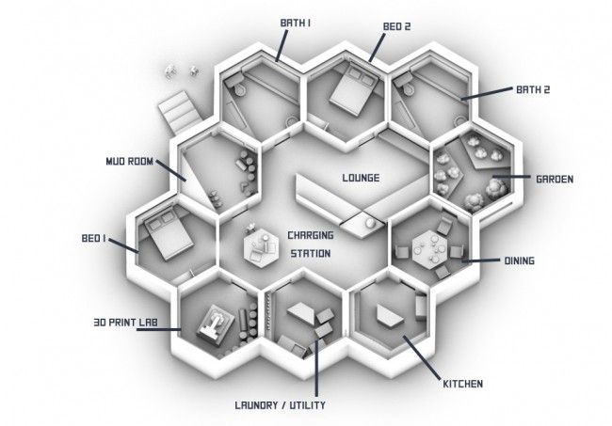
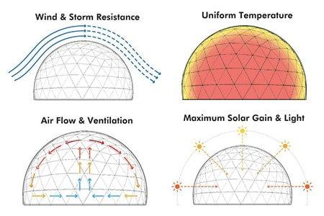
Our Structure Design Features
Our design will incorporate hexagonal towers due to the fact that hexagons are proven to be the strongest shape in nature
Use of hexagonal design will ensure that strong winds, sand storm and marsquakes (Very Rare) cannot impact lives
Hexagons can also be easily connected similar to bee hives which can help make more rigid structures however failure of one will not affect others (for future expansion)
Double sealed and pressurized entries will be available on two sides of buildings along with pressurized rooms inside in case of an emergency

Slide 7
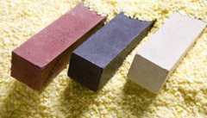
Materials
Usage of sulfur concrete to make a strong base
Requires heating sulfur and an aggregate (sand, gravel, etc.) to above the melting point of sulfur and cooling it
The martian soil has the calcium and carbon found in limestone to create sulfur concrete on mars.

Slide 8
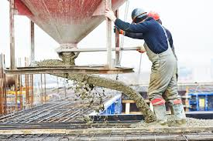
Admixtures
Though sulfur concrete is strong, it can easily melt when exposed to heat
Admixtures can be added to sulfur concrete to prevent it from burning until 240 degrees fahrenheit.
Admixtures are natural or manufactured chemicals which are added to the concrete before or during mixing.

Slide 9
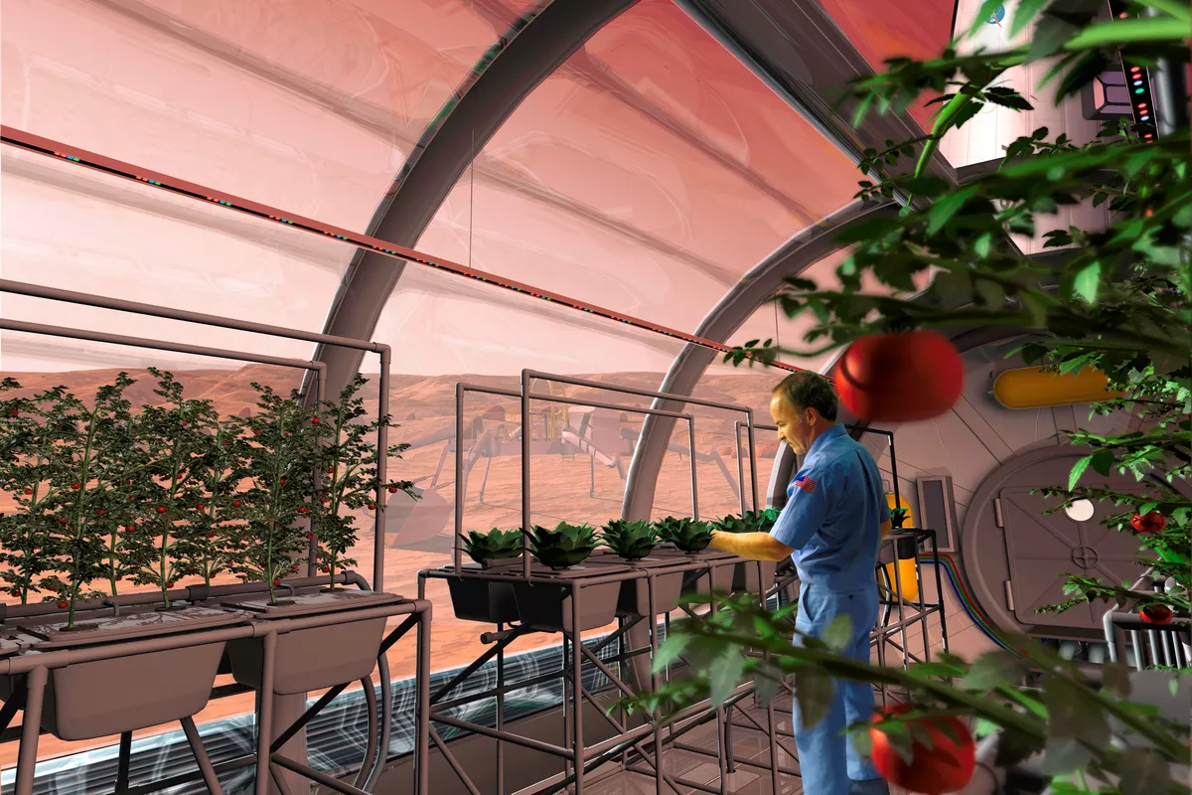
Sustainability of Structure
In order to live on mars permanently the 5 habitants must slowly stop relying on earth resources
Botany can be easily incorporated on Mars and in our structures
This will be done by using human waste (Solid/Liquid) alongside filtration system. This will minimize food transport from Earth
Growing crops is also beneficial due to photosynthesis and production of Oxygen by plants.
Oxygen can also be generated by a similar system developed by MOXIE taking advantage of the ~96% carbon dioxide in the atmosphere

Slide 10
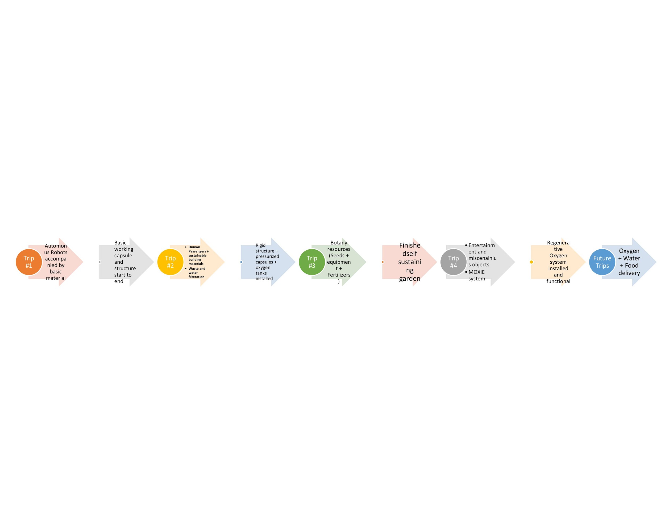

Slide 11
Sources
https://cen.acs.org/articles/96/i1/build-settlements-Mars-ll-need.html
https://www.nasa.gov/vision/space/travelinginspace/radiation_shielding.html
https://www.canadametal.com/wp-content/uploads/2016/08/radiation-shielding.pdf
https://www.nasa.gov/feature/langley/a-new-home-on-mars-nasa-langley-s-icy-concept-for-living-on-the-red-planet
https://www.cnbc.com/2019/05/24/pictures-nasa-approved-designs-for-3d-printed-homes-on-mars.html
https://www.accessscience.com/content/sulfur-concrete-as-a-construction-material-on-mars/BR0208161
https://www.youtube.com/watch?v=7rzu7TTkIMAhttps://www.spacex.com/falcon-heavy
https://mars.nasa.gov/resources/22532/crazy-engineering-making-oxygen-on-mars-with-moxie/

Slide 12
The End

